Slide 1
Coursera Capstone IBM Applied Data Science Capstone Opening a New Cafe in Mumbai, India
By: NISHCHAY NAGPAL
JULY, 2020

Slide 2
Business Problem
Objective: To analyze and select the best locations of Cafes in the city of Mumbai, India to open a new cafe
Location of the cafes is one of the most important decisions that will determine whether the shop will be a success or a failure
Business question
In the city of Mumbai, India, if a person is looking to open a new cafe, where would you recommend that they open it?

Slide 3
Data
Data required
List of neighborhoods in Mumbai
Latitude and longitude coordinates of the neighborhoods
Venue data, particularly data related to cafes
Sources of data
Wikipedia page for neighborhoods (https://en.wikipedia.org/wiki/Category:Suburbs_in_Mumbai)
Geocoder package for latitude and longitude coordinates
Foursquare API for venue data

Slide 4
Methodology
Web scraping Wikipedia page for neighborhoods list
Get latitude and longitude coordinates using Geocoder
Use Foursquare API to get venue data
Group data by neighborhood and taking the mean of the frequency of occurrence of each venue category
Filter venue category by Café
Perform clustering on the data by using k-means clustering
Visualize the clusters in a map using Folium

Slide 5
Results
Categorized into 5 neighborhood clusters:
Cluster 0: Neighborhoods with low number of Cafe
Cluster 1: Neighborhoods with moderate number to no existence of Cafe
Cluster 2: Neighborhoods with high concentration of Cafe
Cluster 3: Neighborhoods with highest concentration of Cafe
Cluster 4: Neighborhoods with moderate concentration of Cafe

Slide 6
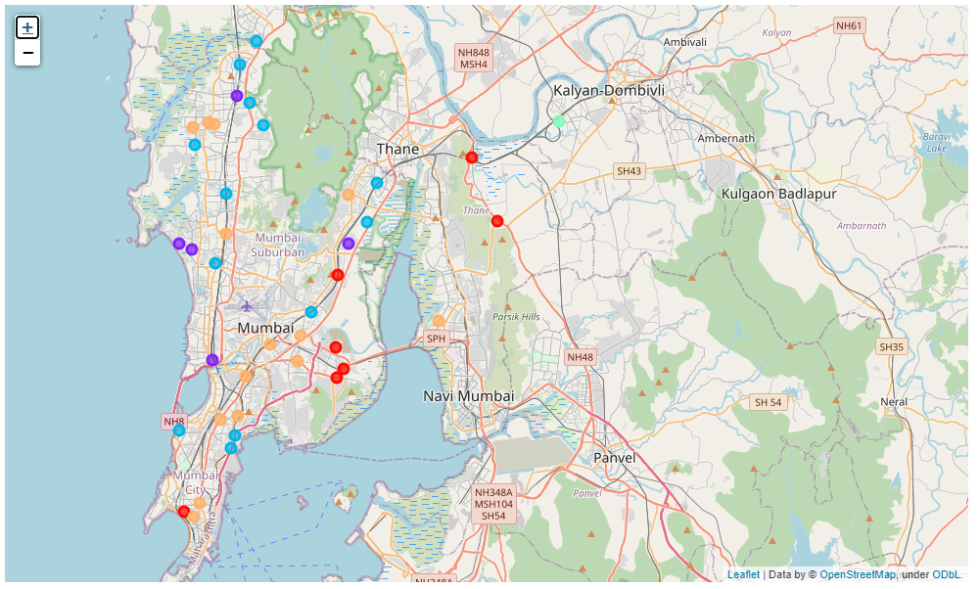

Slide 7
Conclusion
Cafes are concentrated in the southern and eastern area of Mumbai
The highest number in cluster 2 and moderate number in cluster 4, cluster 0 has very low number to totally no Cafes in the neighborhoods.
This represents a great opportunity and high potential areas to open new Cafes as there is very little to no competition from existing shops.
Meanwhile, cafes in cluster 3 are likely suffering from intense competition due to oversupply and high concentration of cafes.
This project recommends developers to capitalize on these findings to open new cafes in neighborhoods in cluster 0 with little to no competition.
Developers with unique selling propositions to stand out from the competition can also open new cafes in neighborhoods in cluster 2 and cluster 4 with moderate competition.
Lastly, developers are advised to avoid neighborhoods in cluster 3 which already has high concentration of cafes and is suffering from intense competition.

Slide 8
Thank You

